Slide 1





Adaptive Metasurface-based Acoustic Imaging using Joint Optimization
Yongjian Fu, Yongzhao Zhang, Yu Lu, Lili Qiu, Yi-Chao Chen, Yezhou Wang,
Mei Wang, Yijie Li, Ju Ren, Yaoxue Zhang
ACM MobiSys 2024
Notes:
Hi everyone. Thank you for attending my presentation. This is Yongjian.Today, I’m going to introduce our work, adaptive meetasurface-based acoustic imaging using joint optimization.

Slide 2
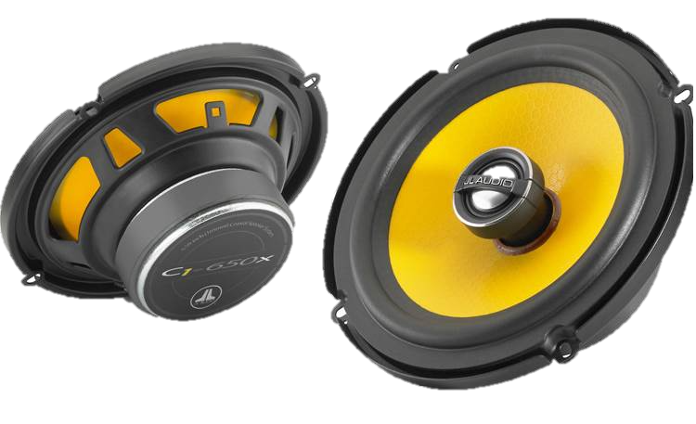

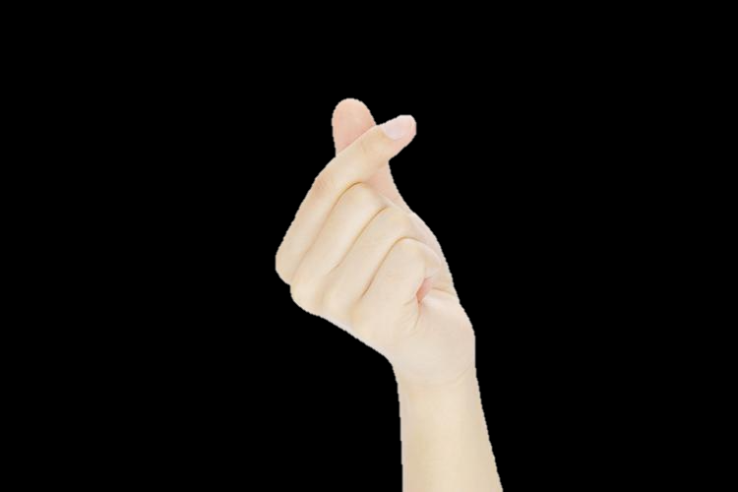
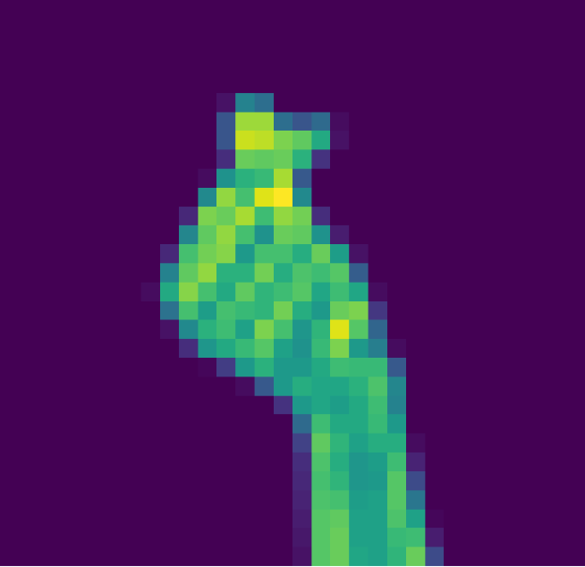
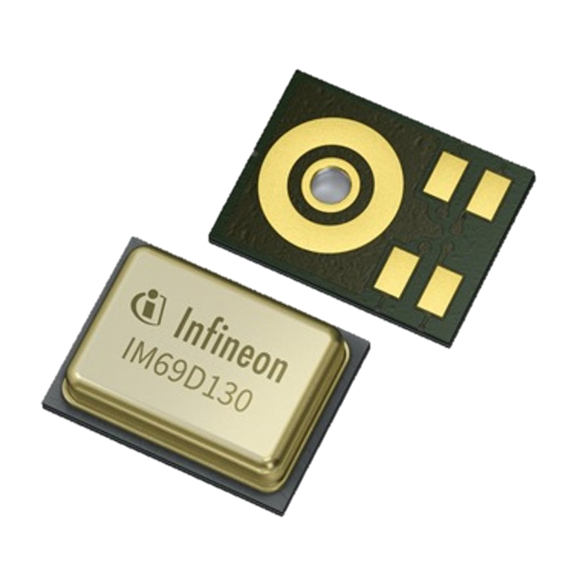



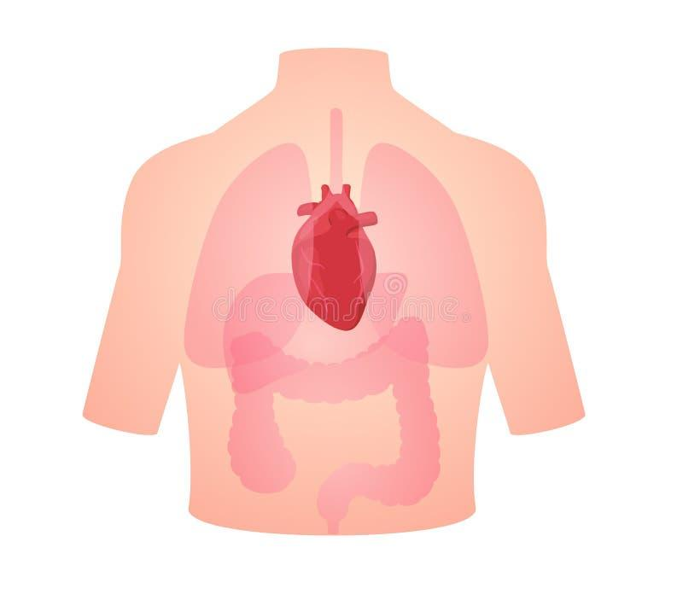

Enabling Acoustic Imaging on IoT Devices
Speakers
Microphones
Low-light condition
NLOS sensing
In-body sensing
Notes:
Acoustic imaging uses speakers and microphones as the transmitter and receiver. It employs acoustics as the medium to create images of the targets. Unlike cameras, acoustics will not be affected by lighting conditions. And they can go through certain materials, allowing for NLOS sensing in some cases. Besides, acoustics can even penetrate human tissues, making it possible to do some in-body sensing like detecting internal organs.

Slide 3
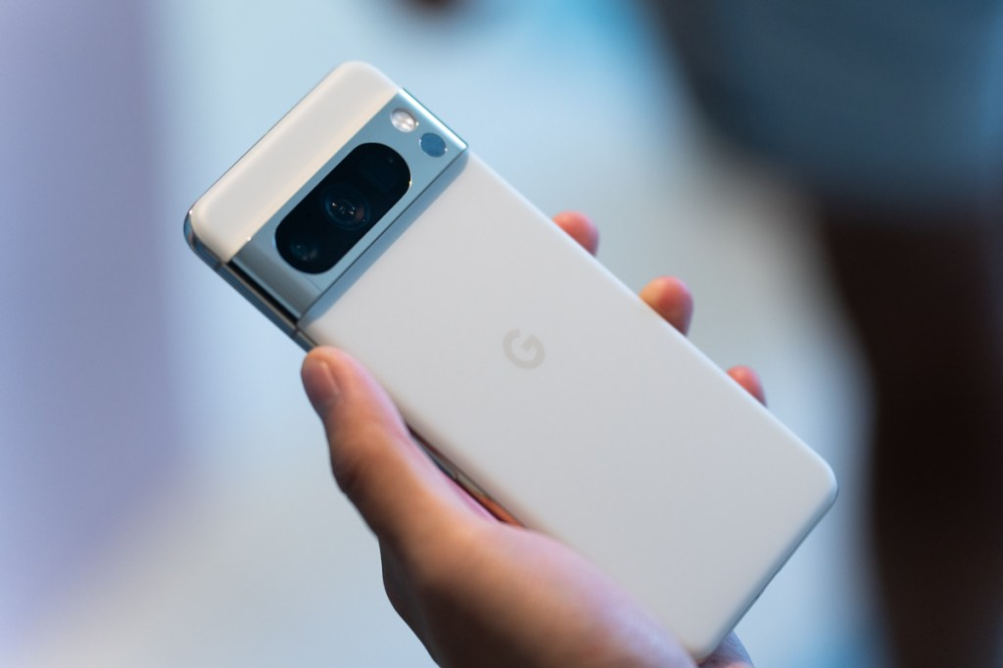
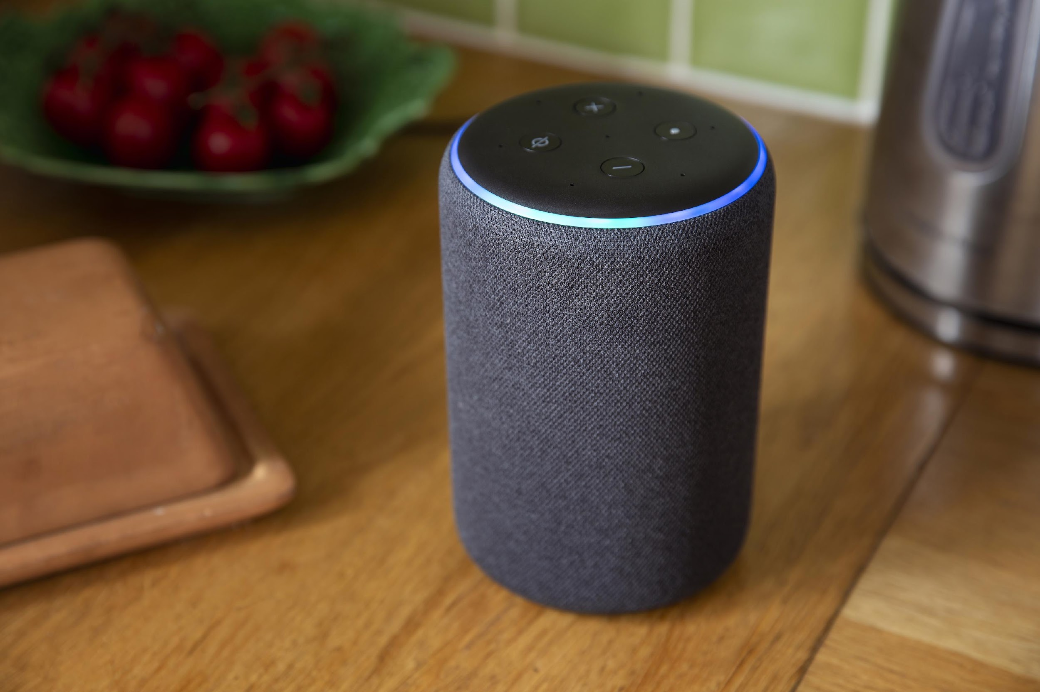
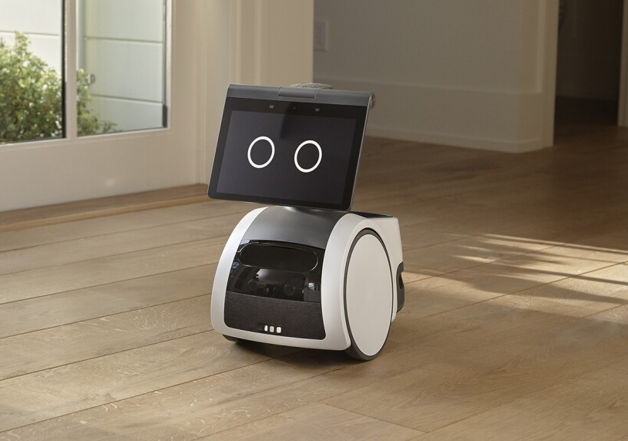
Enabling Acoustic Imaging on IoT Devices
Smartphones
Smart speakers
Mobile robots
Notes:
Imagine that if we could implement such acoustic imaging functionality using the built-in speakers and microphones on the IoT devices, such as smartphones, smart speakers, or mobile robots. This would open up opportunities to develop entirely new sensing applications.

Slide 4
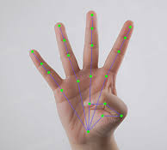
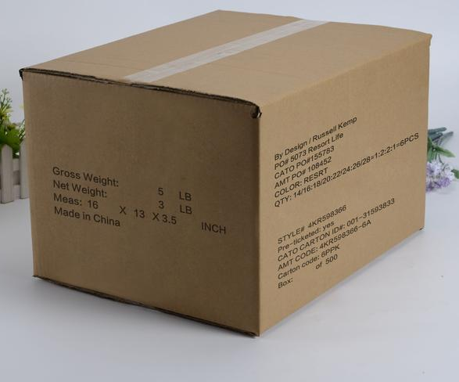
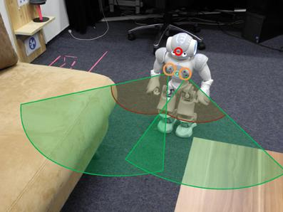
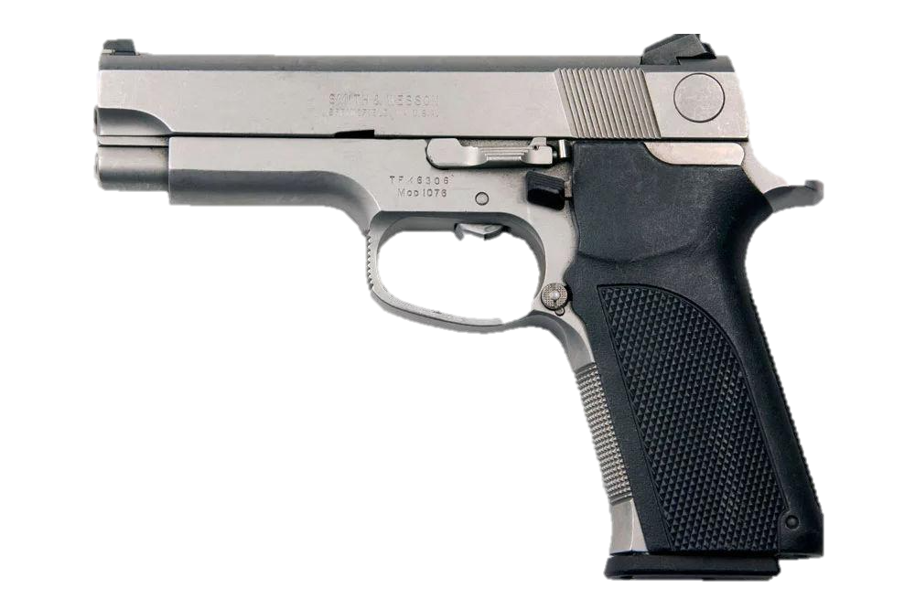
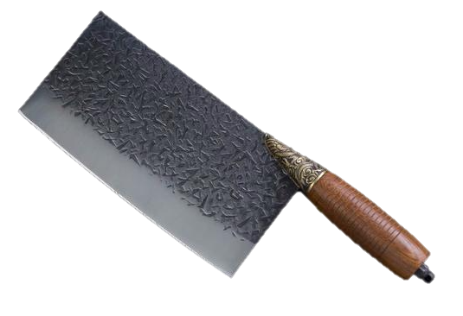
Enabling Acoustic Imaging on IoT Devices
Such imaging functionality can fundamentaly change the way of acoustic sensing.
Dangerous Items!!!
Notes:
For example, we can enable acoustic vision for fine-grained human sensing, like gesture estimation. Also, we can reuse these iot devices as ultrasound in-box detector for security check. Moreover, acoustic imaging could provide fine-grained radar sensing ability, which is particularly useful in scenarios where cameras are disabled. The potential of acoustic imaging doesn’t stop there, and it may even bring new capabilities to healthcare in the near future.

Slide 5
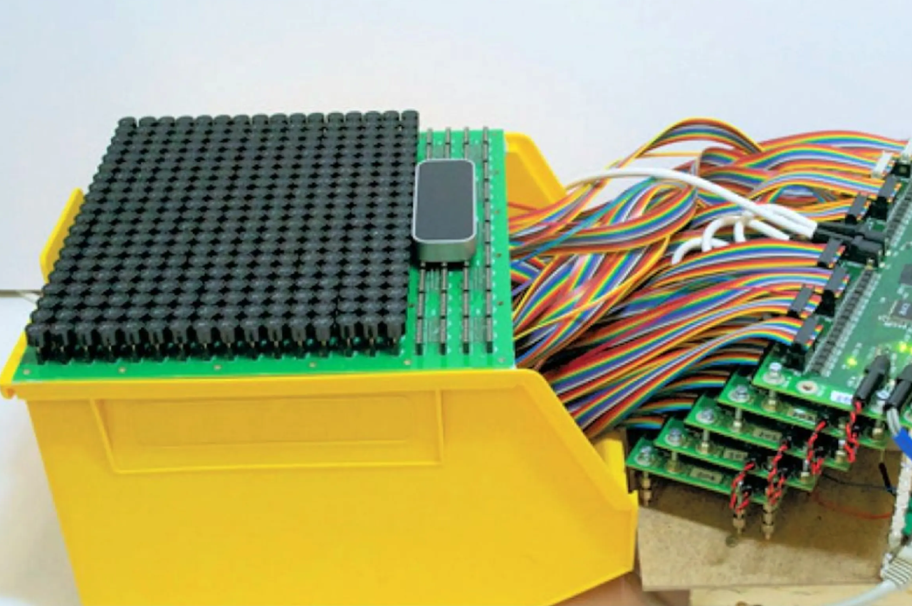
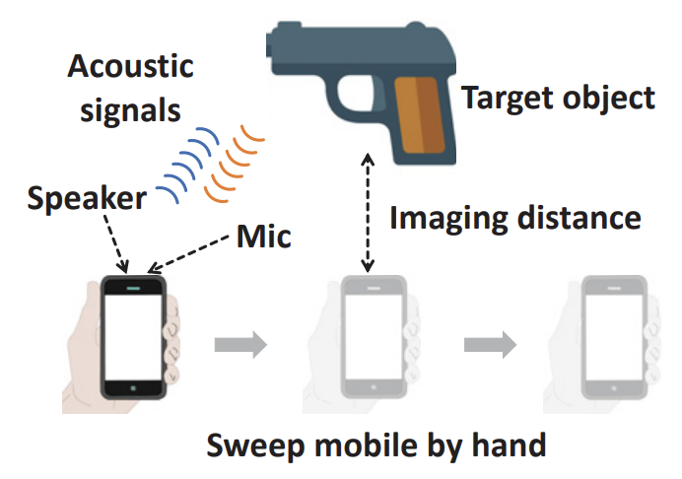
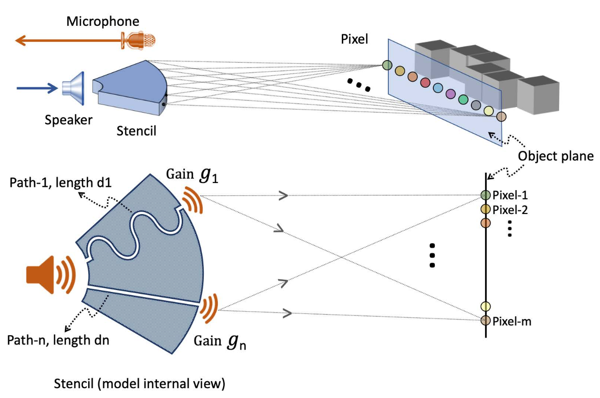
Related Works of Acoustic Imaging
Using large array
Requiring mechanical movement^{[1]}
Limited scalability^{[2]}
[1] Mao, Wenguang, Mei Wang, and Lili Qiu. "Aim: Acoustic imaging on a mobile." ACM MobiSys. 2018.
[2] Bai, Yang, Nakul Garg, and Nirupam Roy. "Spidr: Ultra-low-power acoustic spatial sensing for micro-robot navigation." ACM MobiSys. 2022.
Expensive! Time-consuming! Limited scalability!
Notes:
However, current acoustic imaging methods often rely on expensive and complex array, which makes it difficult
to fully adapt for IoT devices. Some researchers try to address this problem by using device movement and SAR algorithms.But in real world, we can not always ensure sufficient driving force and time to achieve the desire motion. The advanced work uses 3D printed stencil to enable acoustic vision capabilities for microrobots. However, its original intention for ultra-low power consumption and limited expansion design prevent it from producing clear images. So enabling low-cost and usable acoustic vision for IoT devices remains an open challenge.

Slide 6
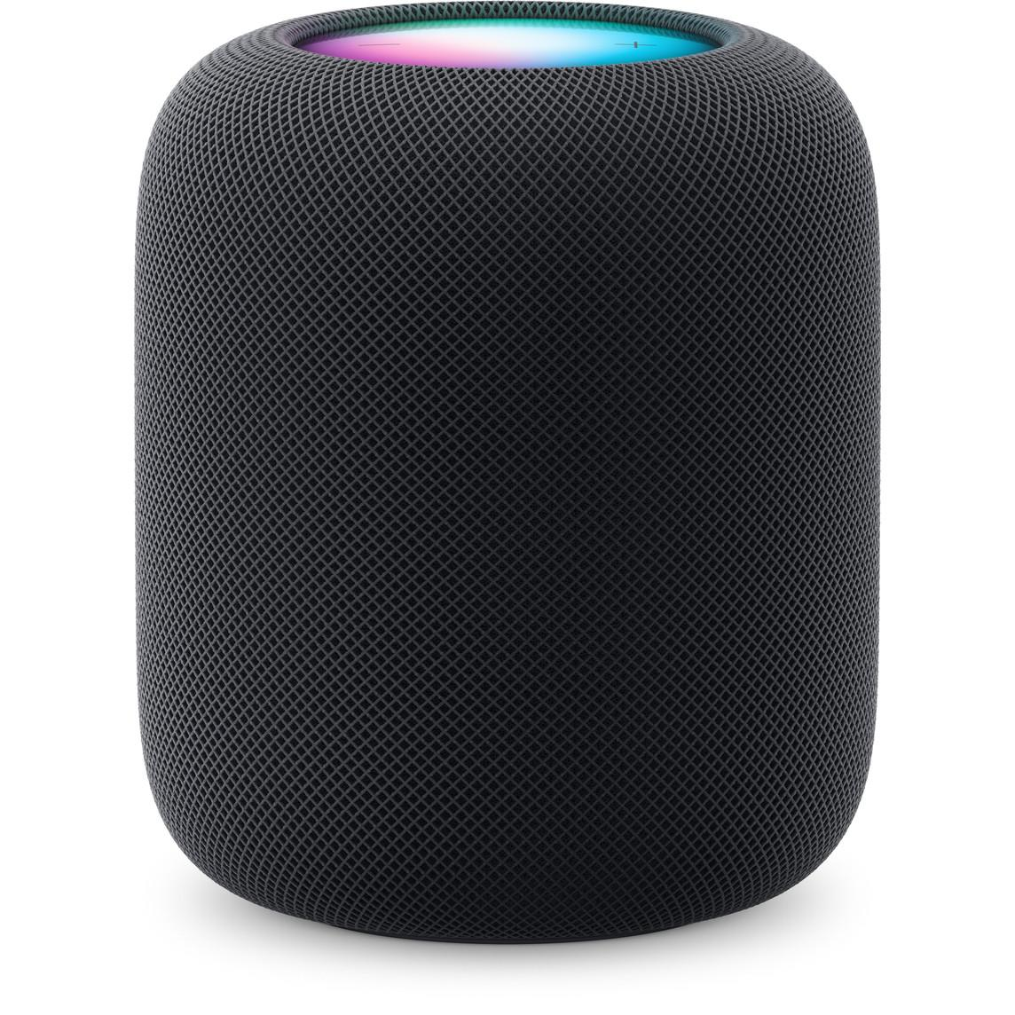
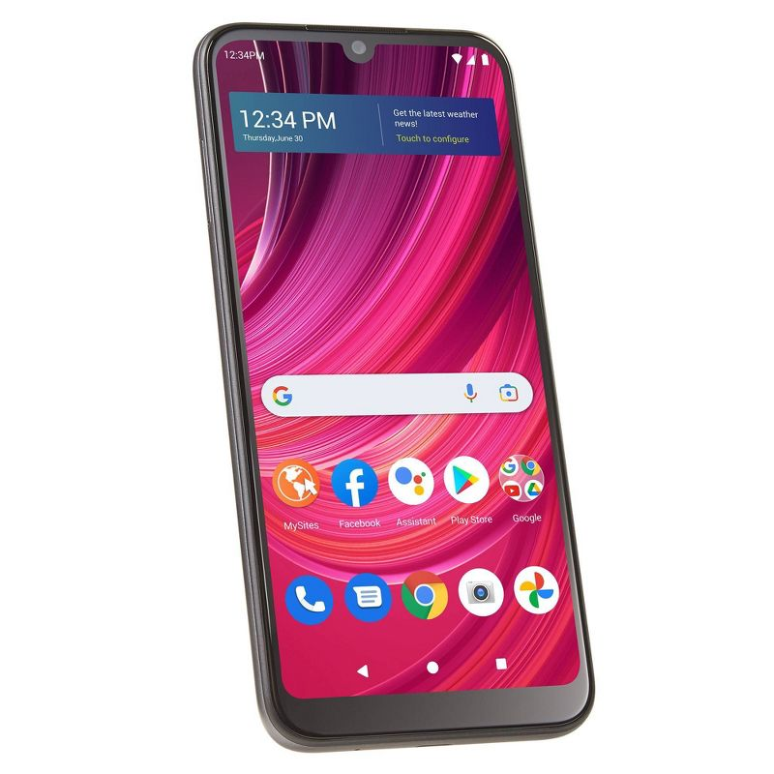
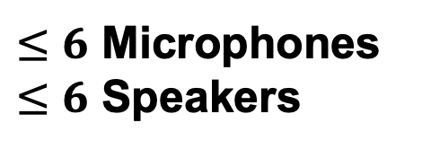
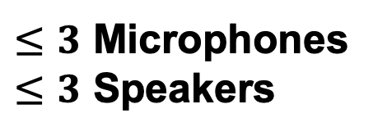
Limitations of Current Acoustic Imaging on IoT Devices
Can we achieve accurate acoustic imaging on IoT devices?
Notes:
For a typical IoT device, we only have a few microphones and speakers available. Especially compared to the optical imaging system with millions detection units, such IoT device seems inadequate for producing high-quality images, Therefore, in our work, we try to answer one question: Can we achieve accurate acoustic imaging on IoT devices?

Slide 7










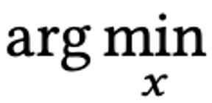
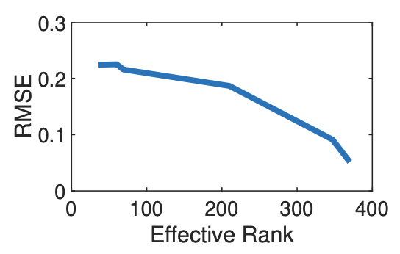
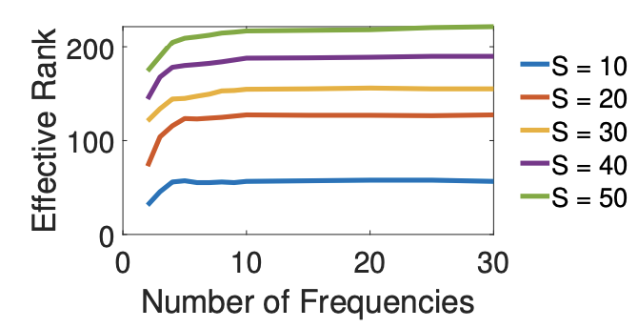








Effective Rank Defects for Imaging
Forward propagation
The received signal of each microphone:
$$R_{m}=$$
$${ H}_{o,r}$$
$$O∙$$
$$H_{t,o}w$$
$$+ ε$$
$$=A\left(w\right)O+ε$$
Phase shifter
Rank-sufficient
…
Phase shifter
We can infer the image O by optimizing (rank-deficient):
Speaker Array
Phase shifter
…
Phase shifter
Mic Array
Backward propagation
Acoustic Imaging is limited by the effective rank of measurement matrix!
Notes:
We try to answer this question start from the imaging formulation. Assuming we already have microphones and speakers. For imaging the received signal by microphones can be formulated as follows, the speakers will transmit signal after beamforming w, and then passing through a channel between the target and speakers. There are a predefined imaging area, we discretize this area into voxels. The value of each voxel represents the signal reflectivity at that point. The target in the imaging area will reflect some signals back to the microphones after passing through another channel between the microphones and the target. We assume the imaging process is based on the AWGN model, so there is a noise item.Therefore, the process can be simplified into a linear problem, here we have y=Ax, where x is image, y is the samples captured by microphones, and A is the measurement matrix. It can be changed by using different beamforming weights. The rows of A is the number of samples, and the columns is the number of pixels that we want to predict. If the sampling is highly sufficient, that means the measurement matrix is rank-sufficient, then we can easily infer the image. However, in most cases, it’s undersampled, so we need to use some optimization algorithms to infer the image, and we should note that the imaging error is closely related to the rank. If we want to get an accurate image, a simple way is to use more transceivers or frequencies to increase non-linear samples. However, using large arrays is costly, and the gain from using multiple frequencies converges quickly. So, for the IoT devices, we need to seek for other acceptable solutions to increase the rank of the measurement matrix.

Slide 8
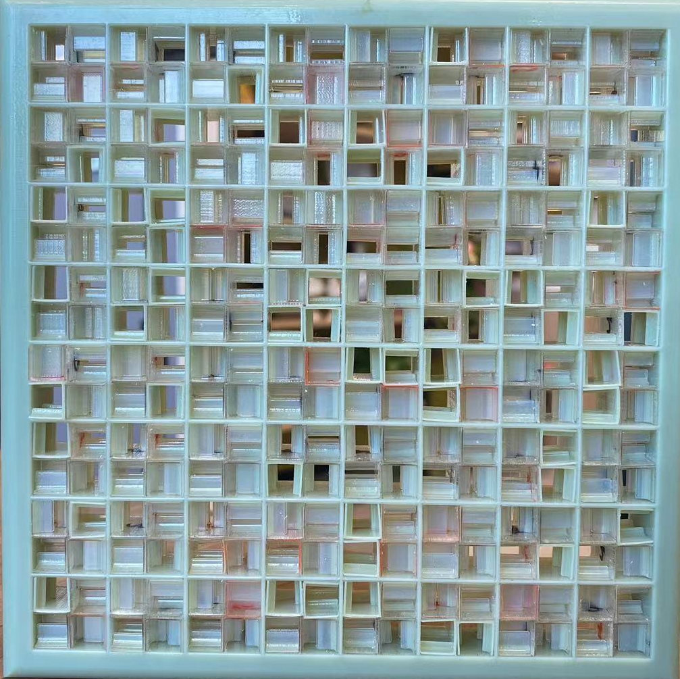
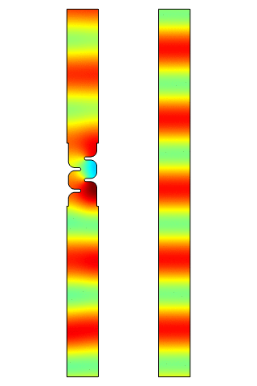


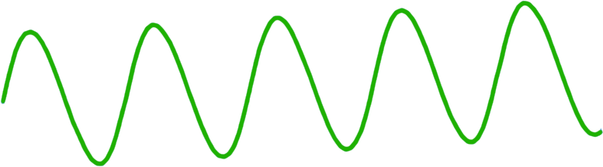


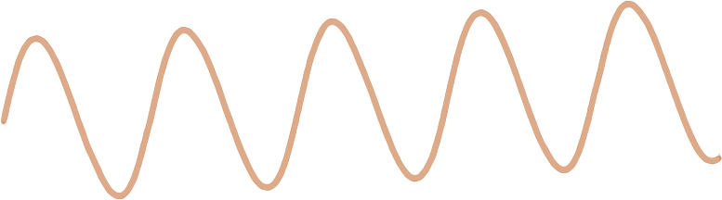


Enhancing the Rank using Acoustic Metasurface​
unit cell
Incident wave
d₁
Outgoing wave
d₂
Notes:
We address this challenge by using a 3D-printed passive acoustic metasurface. This metasurface consist of many cells arranged in half-wavelength patterns. For each cell, we can control the propagation path of the signal by adjusting two length parameters, d1 and d2. We place the metasurface in front of the speakers and microphones as an acoustic lens. Our purpose is not for focusing, instead, we use the dispersion across different frequencies to generate diverse beam patterns, thereby increasing the rank of the measurement matrix.

Slide 9
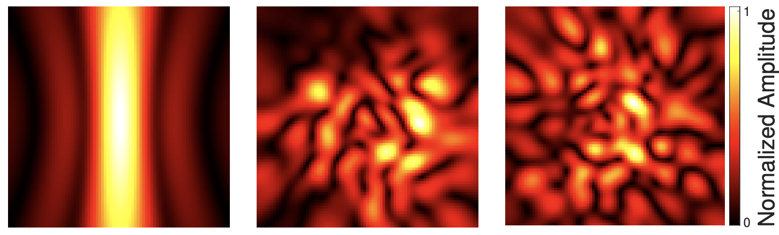
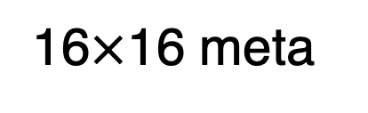
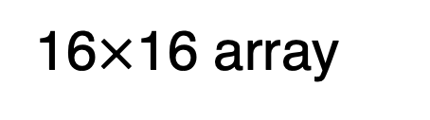
More Powerful and Diverse Beamforming Capabilities
azimuth
elevation
6spk, 4mic
Sound field distribution in space
Notes:
We can see that in the acoustic field distribution when there is a small array, the ability for beam controlling is very limited. But by plus a metasurface, we can enhance the beamforming capability to a level comparable to using a transceiver array with the same size.

Slide 10

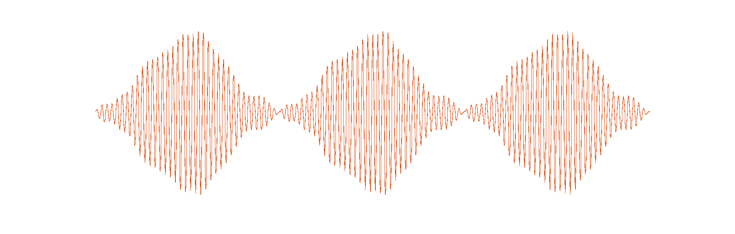
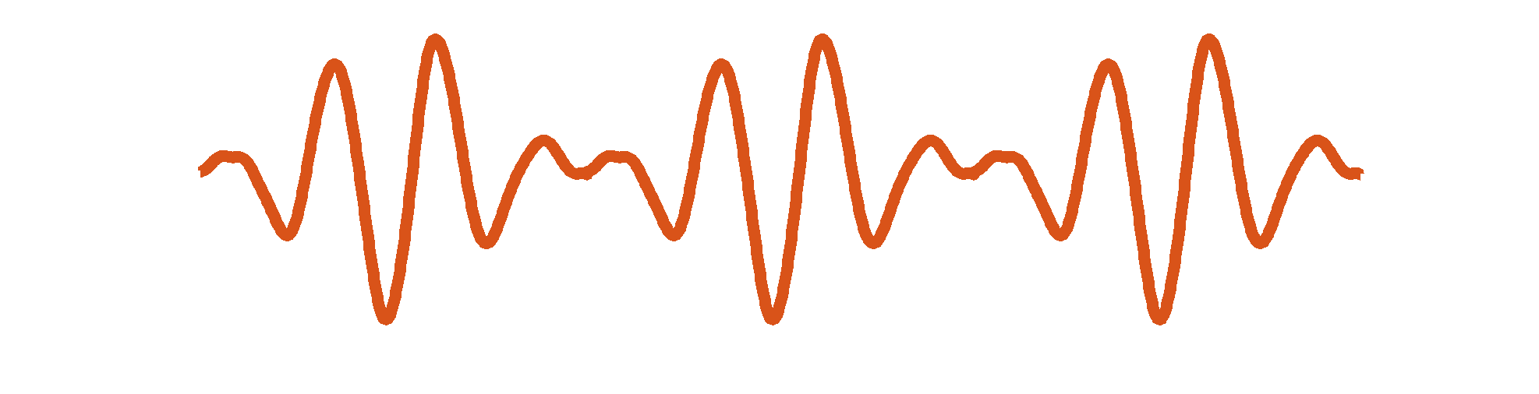
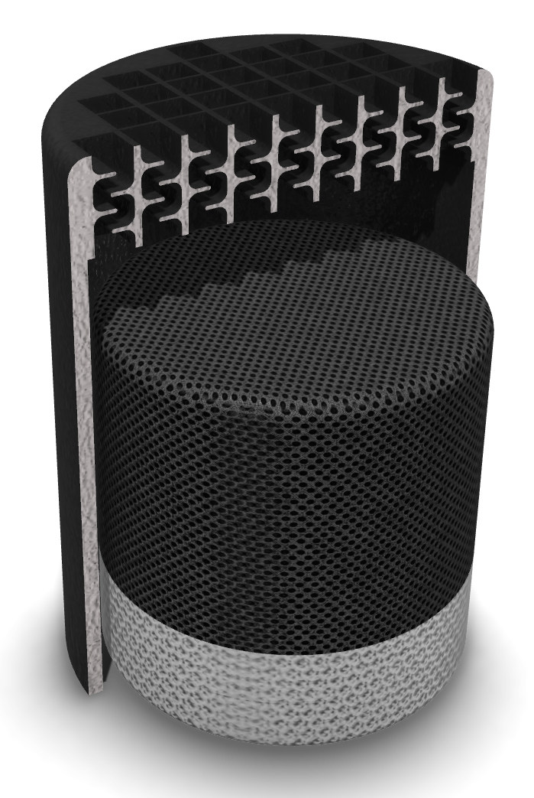
Integrating Acoustic Metasurface as Device Shell
Ultrasound
Speech
Passive Structure
Mic Array
Notes:
Another thing we want to mention is that such 3d-printed surface can be easily integrated into existing IoT devices as a shell. This will almost not bring additional cost overhead, since we only use the normal 3d-printed material for the metasurface.

Slide 11


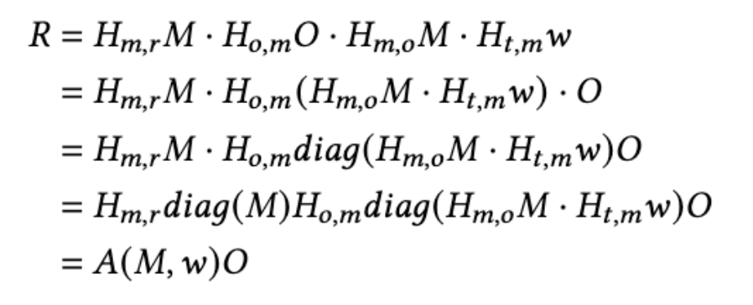


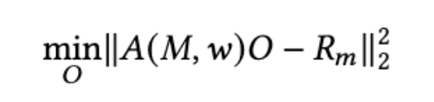


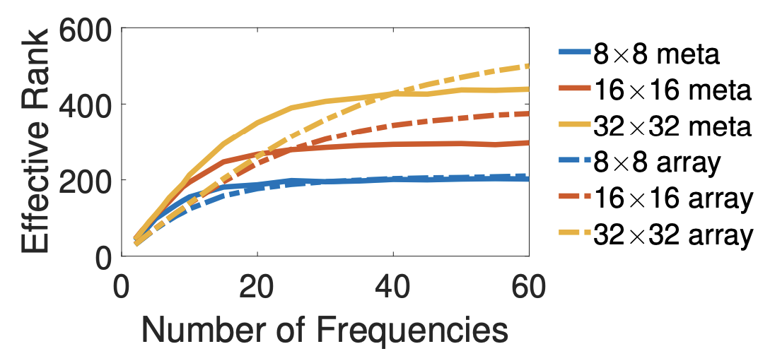


Enhanced Measurement Matrix using Metasurface
Forward propagation
The received signal of each microphone:
Phase shifter
…
Phase shifter
Speaker Array
We can infer the image O by optimizing:
Phase shifter
…
Phase shifter
Mic Array
Enhancing the rank like lager arrays!
Backward propagation
Notes:
After integrating the metasurface, we re-model to account for its impact on the measurement matrix. Now, our measurement matrix A has the added effect of metasurfaces. We use a random metasurface and try to vary its size, and observe that the metasurface will increase the rank to a level comparable to a transceiver array in the same size. This enhancement continues to be improved as the metasurface size increases. However, considering the shape factor constraints of the IoT devices, we need to limit the size of the metasurface within a certain range, and this constraint will limit the imaging performance. For example, if we have 1000 voxels in the imaging area, a 16 by 16 random metasurface can only provide a rank of 372. This means relying only on random metasurfaces and simple imaging optimization algorithms is not enough to achieve high-quality imaging.

Slide 12
Design Challenges
How to design an imaging algorithm achieve high imaging quality?
How to jointly optimize beamforming, metasurface, and imaging algorithms?
How to maintain high imaging quality across a wide range of distances?
Notes:
So, in order to enable high-quality acoustic imaging on IoT devices, we need to further answer the questions . First ,we should think about what kind of imaging algorithm should we use to achieve better imaging quality? This step is critical and we need to consider how computational methods can be used to make up for the lack of sampling. Second, we need to find a way for beamforming, metasurface, and imaging algorithm to work well together, so that we can maximize the contribution of the designable components for imaging.Third,as mentioned before, our imaging area is predefined, so how can we adapt the system to different imaging areas to make it more flexible, such as achieving longer range. To address these challenges, we have the following designs.

Slide 13
Design Challenges
How to design an imaging algorithm achieve high imaging quality?
A new imaging algorithm that uses unrolled ADMM + refinement network
How to jointly optimize beamforming, metasurface, and imaging algorithms?
How to maintain high imaging quality across a wide range of distances?
Notes:
First, for the imaging algorithm, we use an unrolled ADMM with a learnable neural prior and refinement network.

Slide 14
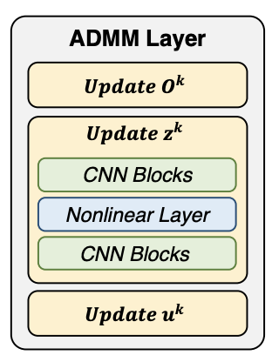
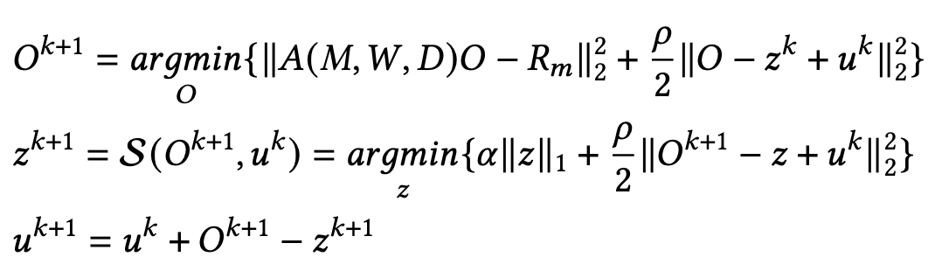

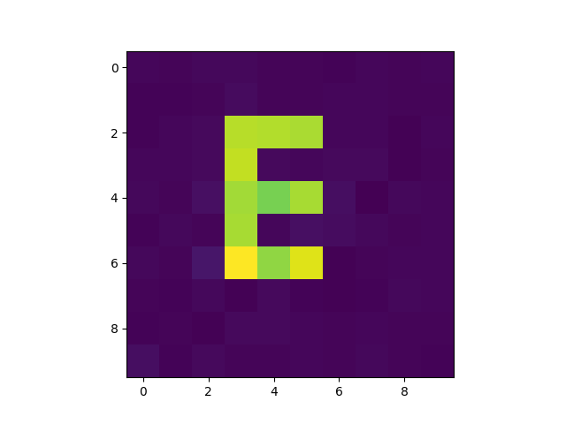


Solution 1: Neural-enhanced Imaging Algorithm
Utilizing sparsity to simplify the optimization:
$$min{\left\|A\left(M,W,D\right)O−R_{m} \right\|}_{2}^{2}+α{\left\|𝒩(z)\right\|}_{1}$$
$$s.t.O−z=0$$
Neural constrains
Using unrolled ADMM to solve this problem:
Refinement Network
Measurement
matrix
…
ADMM Layer
Structure of ADMM layer
ADMM Layer
ADMM Layer
ADMM Layer
Microphone
samples
Images
Notes:
Specifically, our high-level idea is to use constraints to reduce the search space for imaging optimization to reduce the need for the number of samples.we add a learnable neural constrain into the imaging process, and we use an unrolled ADMM, which treat each iteration as a neural layer. For each layer, we use the CNN blocks as the learnable parameters that can be train in the data driven manner. Moreover, we use a U-like network to further recorrect the image. By using such algorithm, we can reconstruct accurate images from undersampled data.

Slide 15
Design Challenges
How to design an imaging algorithm achieve high imaging quality?
A new imaging algorithm that uses unrolled ADMM + refinement network
How to jointly optimize metasurface and beamforming algorithms?
A novel joint optimization framework
How to maintain high imaging quality across a wide range of distances?
Notes:
For the second challenge, we design a novel joint optimization framework

Slide 16

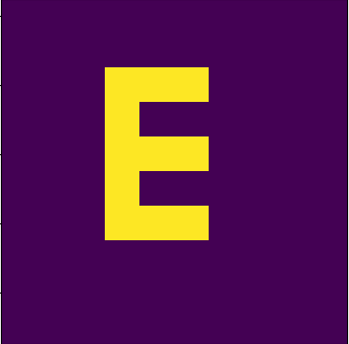



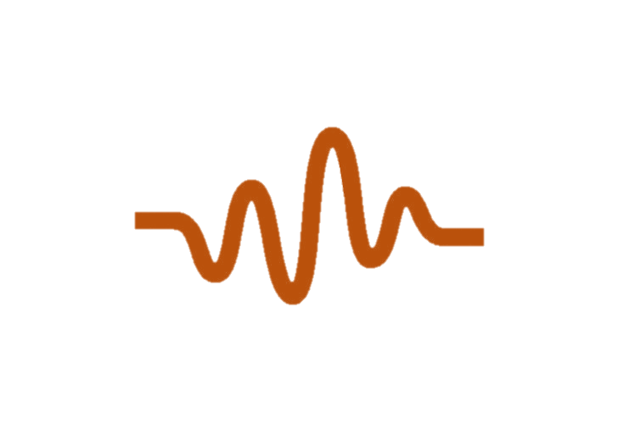






Solution 2: MAJIC: A Joint Optimization Framework
Optimized parameters
M, W, D
Simulator
Imaging Algorithm
Ground Truth
Unrolled ADMM
Refinement Network
Depth
ADMM Layer
MSE Loss
ADMM Layer
ADMM Layer
Object
Transceivers
Metasurface (MS)
Depth
Reconstructed Image
Foward Data Flow
Backward Gradient Propagation
Optimizing System Configuration Using Mean Square Error
Notes:
In the framework, we have a simulator that can reproduce the imaging process and has three optimizable, the metasurface configuration M, beamforming weights for speakers W and microphone D. This simulator can give the measurement matrix and microphones’ samples.The imaging algorithm can use the output of the simulator to infer the image.We put the simulator and algorithm together, and use the MSE Loss and Gradient descent to update all the parameters. By using this framework, we can use imaging quality to guide our design of software and hardware and achieve better imaging quality.

Slide 17
Design Challenges
How to design an imaging algorithm achieve high imaging quality?
A new imaging algorithm that uses unrolled ADMM + refinement network
How to jointly optimize beamforming, metasurface, and imaging algorithms?
A novel joint optimization framework
How to maintain high imaging quality across a wide range of distances?
Adapt imaging resolution and beamforming according to the distance
Notes:
For the third challenge, we propose an adaptive scheme, which can reset the resolution and beamforming for the different distance requirement.

Slide 18
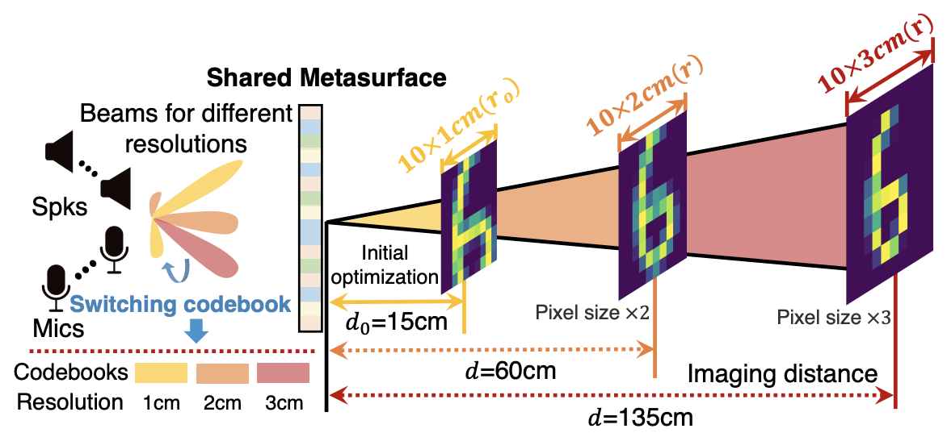
Solution 3: Adaptive Scheme for Varying Distance
Notes:
We observe that larger pixels provide higher SNR, so reducing the resolution can increase the imaging distance. In addition, even though the metasurface is fixed, we can still re-optimize the beamforming to adapt to different distances and resolutions. Such an adaptive scheme makes our system more flexible and usable.

Slide 19
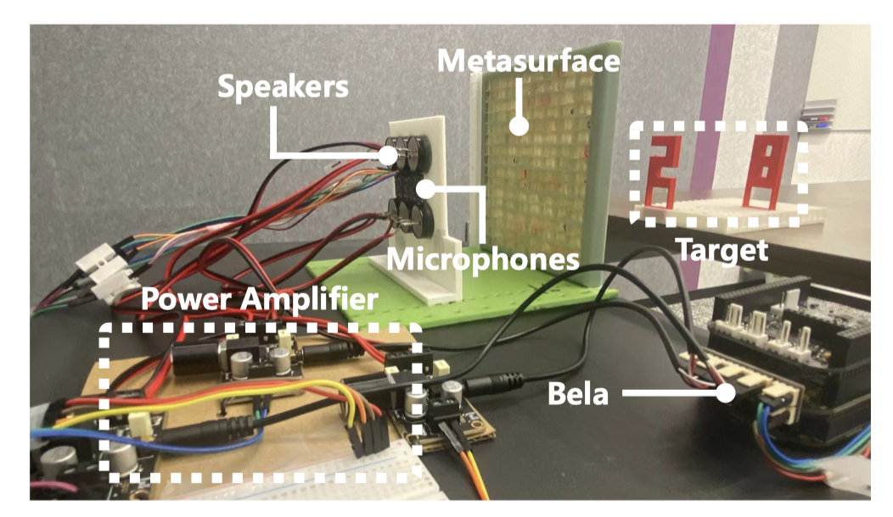
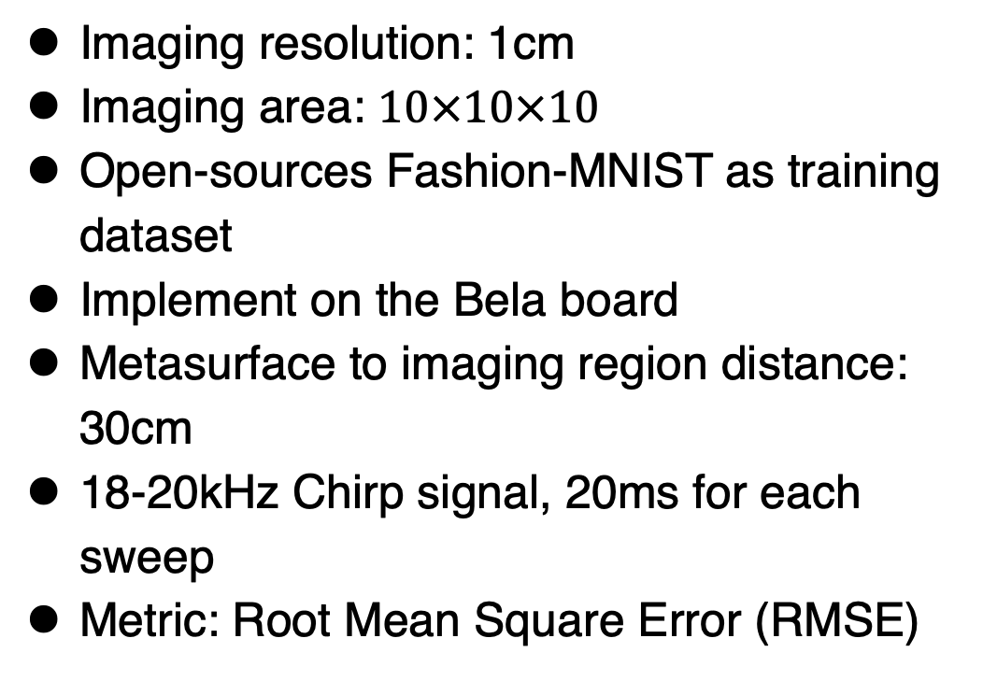
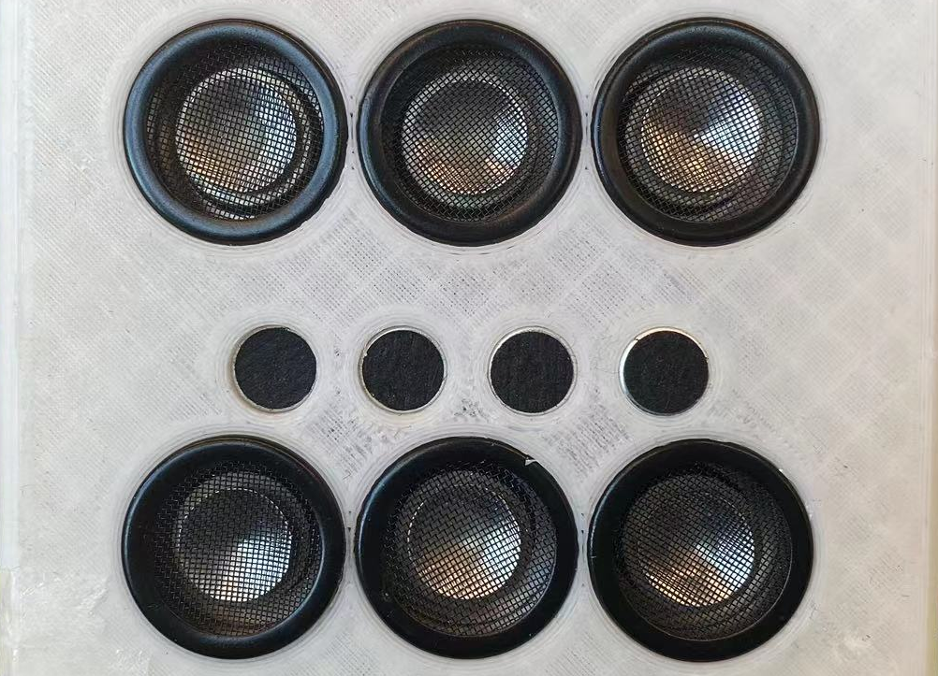
Experimental Setup
a small phased array + a passive metasurface
2x3 commodity speakers
1x4 commodity microphones
16x16 metasurface
Notes:
We hold an imaging resolution at 1 cm and estimate images with 1000 voxels. We use an open-source dataset for training in the simulator. Based on the optimization results, we implement a setup using a Bela board. The distance from the metasurface to the imaging region is 30 cm, and we transmit chirp signal ranging from 18-20 kHz, with each sweep lasting 20 ms. We use RMSE as the error metric.

Slide 20
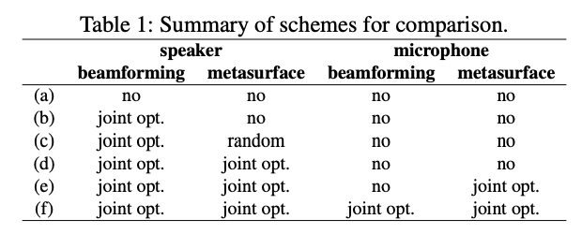
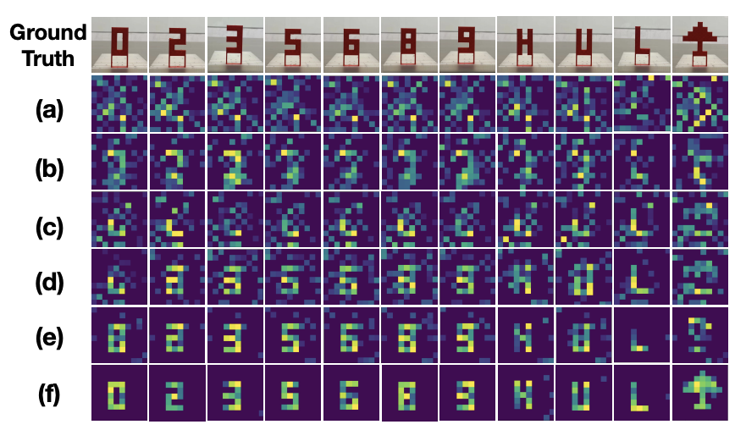
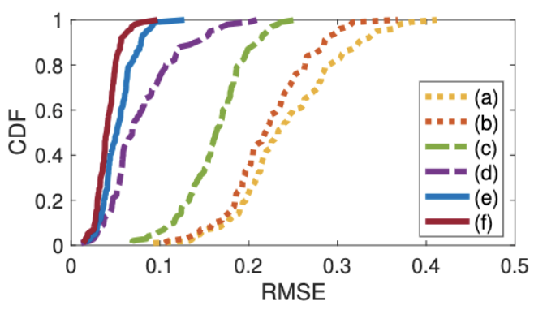
Overall Performance
Performance of various schemes
2D Imaging examples
Achieving 83.1% error reduction compared to no metasurface and optimization
Notes:
We compare our final results with various schemes, each partially disabling some optimizable parameters.We can see from the results, without the metasurface, as in schemes (a) and (b), we can hardly see any objects. With the metasurface,we can see from the (c) to (f), the more parameters we can optimize, the clearer images we can get.Our system can achieve more than eighty percent error reduction compared to no metasurface and optimization

Slide 21
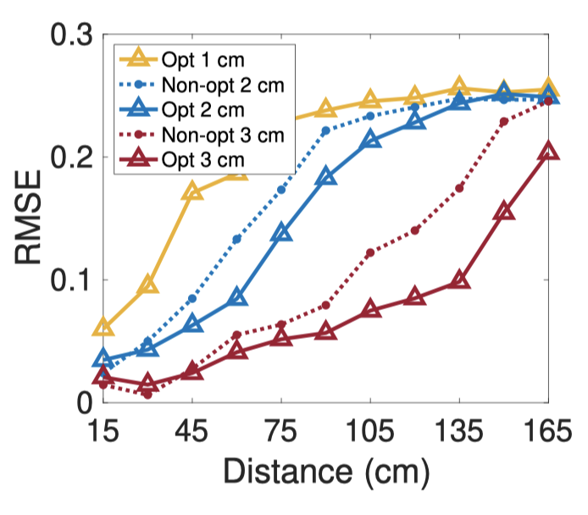
Imaging Performance in Varying distance
Varying distance
Enhancing the imaging distance to 135cm with <0.1 RMSE
Notes:
By re-optimizing the beamforming weights and adjusting the imaging resolution, we can achieve better imaging performance at different distances. Specifically, our imaging system can hold an error lower than 0.1 RMSE at the 135cm away.

Slide 22
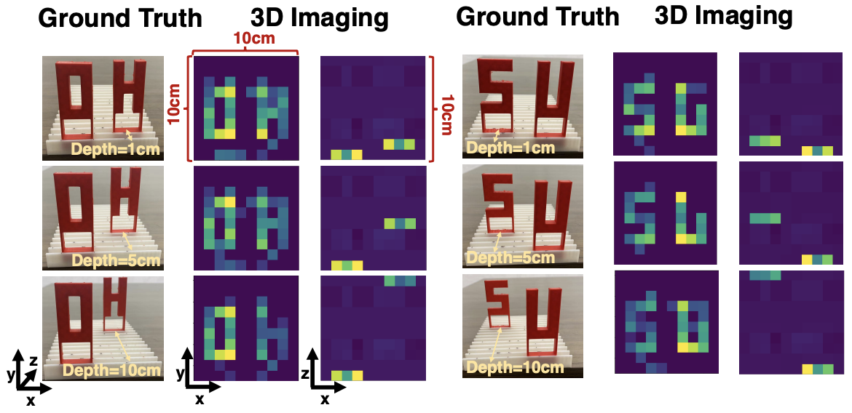
3D Imaging
3D imaging achieves <0.11 RMSE.
Notes:
We also show the various application potentials of our imaging system, such as 3D imaging, our system can achieve less than 0.11 RMSE under various scenarios.

Slide 23


Beyond the camera
Occlusion setup
Image results
Achieving 0.07~0.12 RMSE under occlusion.
Notes:
For the non-line-of-sight imaging, our system can achieve less than 0.12 RMSE under the occlusion of various materials such as clothing, plastic bag and papers.

Slide 24

Gestures recognition
High gesture recognition accuracy!
Notes:
We also test our system’s ability for gesture recognition. The high accuracy shows that our approach can accurately distinguish the shapes of different objects.

Slide 25

Computational Cost
Low computation cost (<10ms) !
Notes:
For the computational cost, it just needs less than 10ms to inference one image, which means that our system can support many real-time applications.

Slide 26

Demo Video

Slide 27
Contributions
Imaging performance is limited by the rank defect and propose to use metasurface and neural priors for imaging.
A joint optimization framework for maximizing the contribution of each designable component.
A prototype and conduct extensive evaluation to demonstrate the effectiveness of the imaging capabilities.

